Slide 1
Knowledge Distillation
CSE 499A
Ahmed Akib Jawad Karim (ID: 1911547042) Anjana Tameem (ID: 1922076042) Kazi Hafiz Md. Asad (ID: 1921880042)

Slide 2
What is knowledge distillation?
Knowledge distillation refers to the process of transferring the knowledge from a large unwieldy model or set of models to a single smaller model that can be practically deployed under real-world constraints.
The main goal is to transferring the knowledge from Big models to Small model [Without significance performance drop]
It makes the model faster, smaller and efficient.

Slide 3
Why not bigger models?
They need more resources and storage to run.
Fine tuning and managing is harder
Procedure is costly
Inference time is more

Slide 4
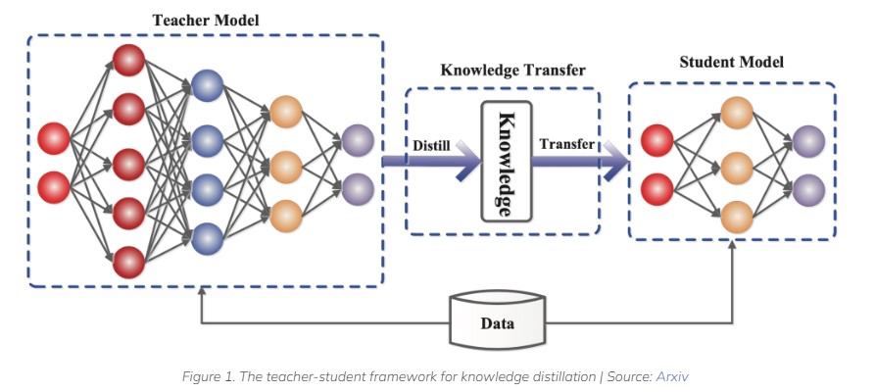
Deep down into Knowledge distillation
Three important components:
The Knowledge
The Distillation Algorithm
The Teacher-Student Architecture
A small “student” model learns to mimic a large “teacher” model with the almost similar accuracy.

Slide 5
Knowledge
In a neural network, knowledge typically refers to the learned weights and biases.
There is a rich diversity in the sources of knowledge in a large deep neural network. Typical knowledge distillation uses the logits as the source of teacher knowledge.
What is a Logit?
A Logit function, also known as the log-odds function, is a function that represents probability values from 0 to 1, and negative infinity to infinity.
The function is an inverse to the sigmoid function that limits values between 0 and 1.

Slide 6
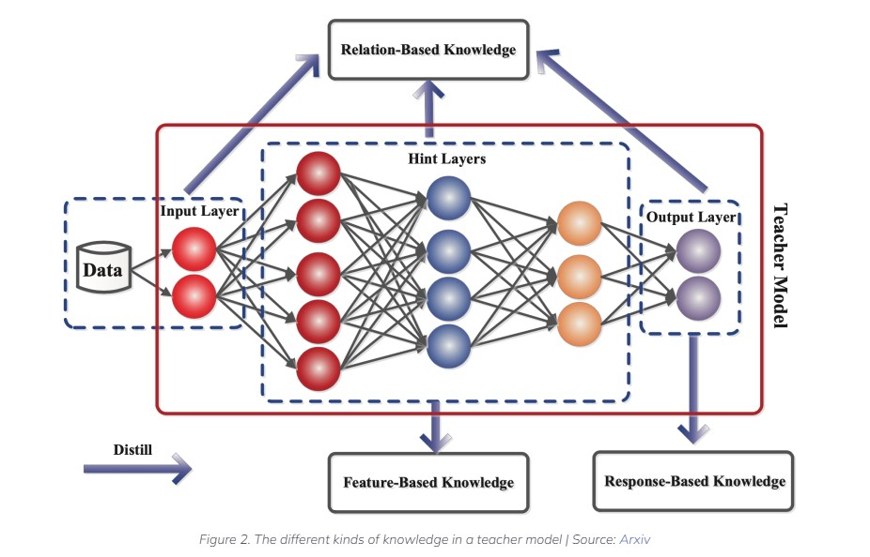
Different forms of knowledge
Response based knowledge: calculates the distilled loss, Final output layer of the teacher model.
Feature based Knowledge: minimizes the difference between the feature activations of the teacher and the student models.
Relation based Knowledge: correlation between feature maps, graphs, similarity matrix, feature embeddings, or probabilistic distributions based on feature representations

Slide 7
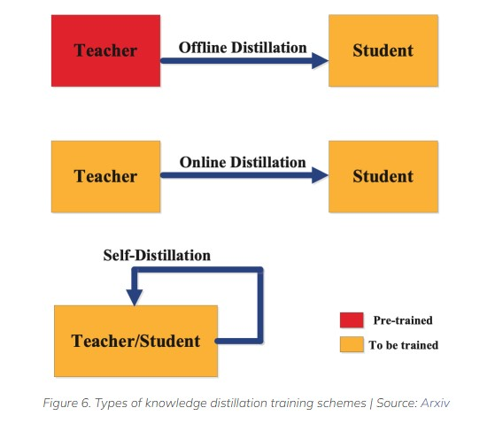
Different forms of distillation(Training)
Offline distillation: the teacher model is first pre-trained on a training dataset, and then knowledge from the teacher model is distilled to train the student model.
Online distillation: both the teacher and student models are updated simultaneously in a single end-to-end training process.
Self distillation: Knowledge from earlier epochs of the teacher model can be transferred to its later epochs to train the student model

Slide 8
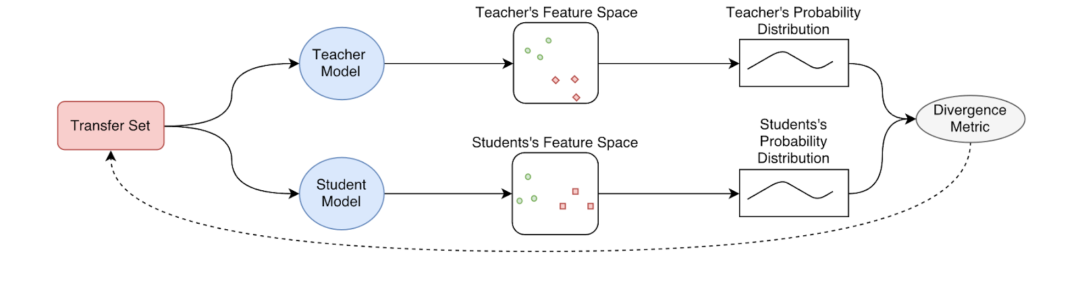
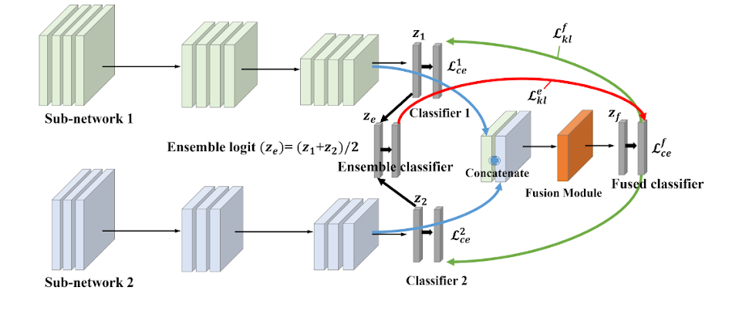
Offline and online distillation
Probabilistic Knowledge Transfer: The knowledge of the teacher model is model using a probability distribution. Then, the knowledge is transferred by minimizing the divergence between the probability distribution of the teacher and the student.
Fig: Offline distillation
OICR includes two parts: Proposal Feature Extractor extracts feature vectors for proposals. Multiple Instance Learning Head aggregates the proposal scores for image level classification. K branches of instance classifiers are sequentially refined for better localization. CASD computes proposal attention maps from each proposal feature maps, aggregates attentions into comprehensive attention maps, and self-distills the comprehensive attention maps to improve WSOD
Fig: Online distillation

Slide 9
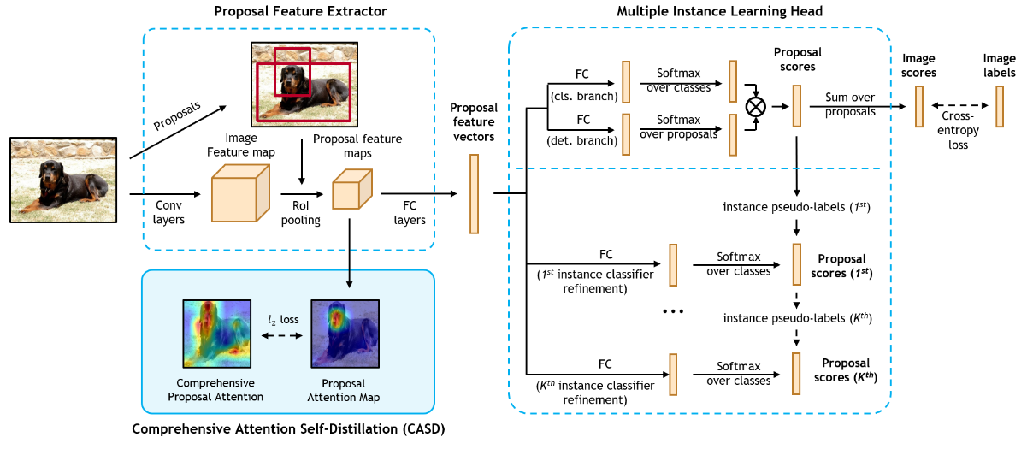
Self Distillation
OICR includes two parts: Proposal Feature Extractor extracts feature vectors for proposals. Multiple Instance Learning Head aggregates the proposal scores for image level classification. K branches of instance classifiers are sequentially refined for better localization. CASD computes proposal attention maps from each proposal feature maps, aggregates attentions into comprehensive attention maps, and self-distills the comprehensive attention maps to improve WSOD

Slide 10
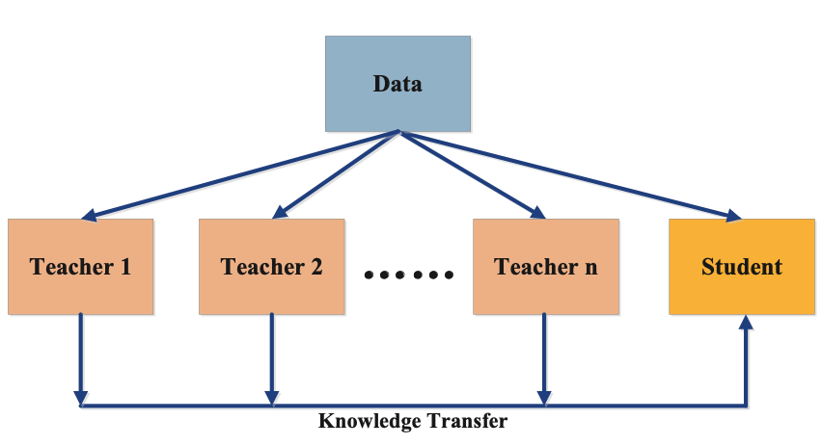
Algorithm for knowledge distillation
Using an ensemble of teacher models can provide the student model with distinct kinds of knowledge that can be more beneficial than knowledge acquired from a single teacher model
Multi-teacher distillation

Slide 11
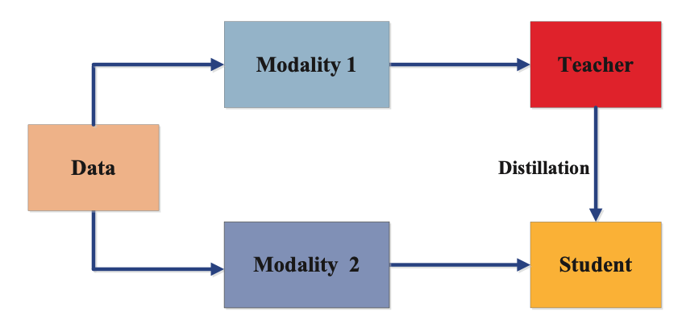
Algorithm for knowledge distillation
the teacher is trained in one modality and its knowledge is distilled into the student that requires knowledge from a different modality.
useful for applications like visual question answering, image captioning amongst others.
Cross Model distillation

Slide 12
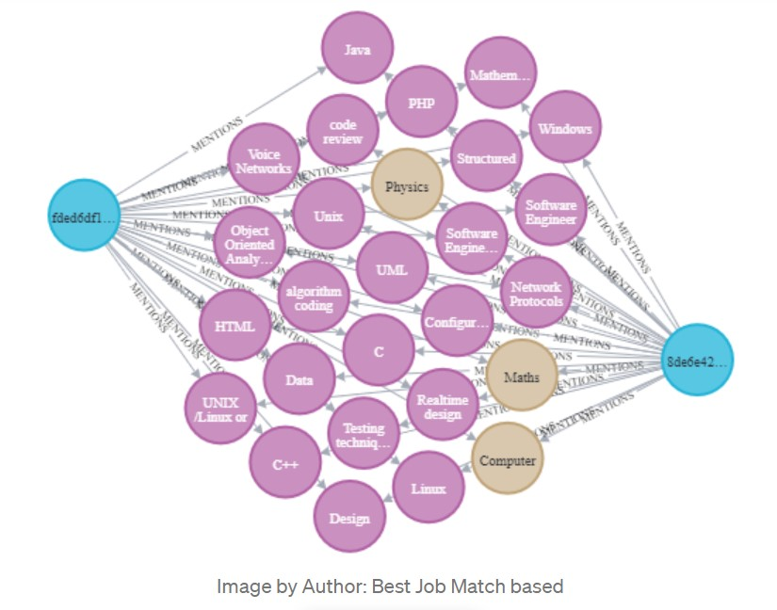
Graph-based distillation
captures intra-data relationships using graphs instead of individual instance knowledge from the teacher to the student.
Graphs are used in two ways – as a means of knowledge transfer, and to control transfer of the teacher’s knowledge.
In graph-based distillation, each vertex of the graph represents a self-supervised teacher which may be based on response-based or feature-based knowledge like logits and feature maps respectively.

Slide 13
Applications of Knowledge Distillation
Computer Vision: image classification, face recognition, image segmentation, action recognition, Object détection etc.
NLP: Neural Machine Translation, Text generation, Question answering, document retrieval, text recognition
Speech: speech recognition, spoken language identification, audio classification, speaker recognition, acoustic event detection

Slide 14
Resources
List the resources :
https://neptune.ai/blog/knowledge-distillation
https://towardsdatascience.com/knowledge-distillation-simplified-dd4973dbc764
https://towardsdatascience.com/how-to-build-a-knowledge-graph-with-neo4j-and-transformers-72b9471d6969
https://www.v7labs.com/blog/knowledge-distillation-guide

Slide 15
Questions & answers
Thank You

